Slide 1

National Core Indicators (NCI)-Informational Meeting
January 4th, 2023

Slide 2
Agenda
Introduction and purpose of NCI
NCI-AD Project Scope
NCI-IDD Project Scope
About the project management organization: Knowledge Services
Survey Management Experience and Approach
Implementation timelines
Questions

Slide 3
Background and Introductions
Developmental Disabilities (DD) and Aging Services are participating
ND advocacy organizations advocated for implementation of NCI
ND State Council on Developmental Disabilities granted funding for the first two years of NCI survey cycles
Collaborative effort
HHS contracted with Knowledge Services for project management

Slide 4
Purpose of NCI-AD and NCI-IDD
Hear directly from people receiving services
Assess quality of life, service satisfaction, experiences, and outcomes of people receiving long term services and supports
Track key outcomes across multiple years, measure performance, and improve systems and quality of supports
Compare outcomes to other states and to the average across states

Slide 5
NCI Indicators
Person-centered service planning
Rights
Choices
Decision making
Relationships
Health
Welfare
Safety
Service coordination
Community inclusion
Employment
Goals

Slide 6







    Data are used to…
Compare outcomes to other states
Compare specific groups or geographic regions within states
Identify areas for quality improvement
Share outcomes with stakeholders for feedback and strategic planning
Benchmark and track progress toward quality improvement
Researchers also use data to look more closely at specific topics

Slide 7


National and State-Level Overview

Slide 8
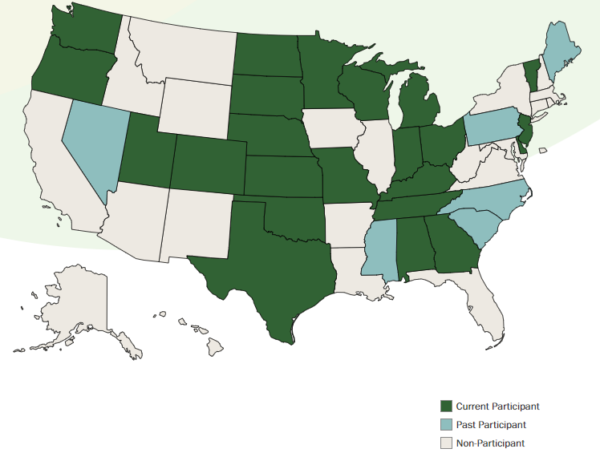
NCI-AD Participating States
Been in use for 7 yrs.

Slide 9
About NCI-AD
Collaboration of Advancing States and Human Services Research Institute (HRSI)
Surveys with older adults or people with physical disabilities, receiving long term services & supports (LTSS)
  HCBS Waiver
  Medicaid State Plan Personal Cares (MSP-PC)
  Service Payments for the Elderly and Disabled (SPED)
  Expanded Services Payments for the Elderly and Disabled (EXSPED)
Administered at the state-level
  States determine their sample strategy with support from NCI team
Standardized survey with a sample of individuals receiving services
Survey conducted in-person, via video conference, or over the phone
Standardized surveyor training
Allows questions to be reworded or rephrased using familiar names and terms
Survey portions take 50 minutes on average

Slide 10



Slide 11
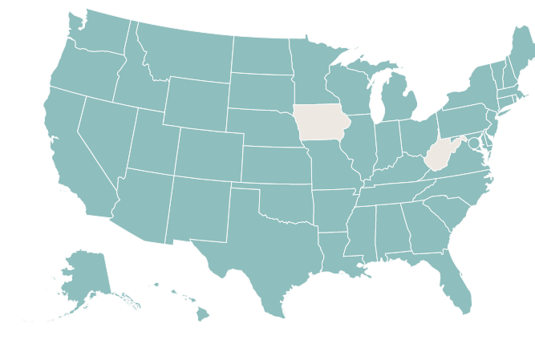
NCI-IDD Participating States
Been in use for 25 yrs.

Slide 12
About NCI-IDD
Collaboration of National Association of State Directors of Developmental Disabilities Services (NASDDS) and Human Services Research Institute (HRSI)
Surveys with people with intellectual and developmental disabilities
  IID/DD HCBS Waiver
  Intermediate Care Facilities for Individuals with Intellectual Disabilities (ICF/IID)
Administered at the state-level
  States determine their sample strategy with support from NCI team
Adult Family surveys (2023 survey cycle)
  Mailed to families with an adult family member with IDD living in the family home
Child Family surveys (2023 survey cycle)
  Mailed to families with a child with IDD living in the family home
Family/Guardian surveys (2024 survey cycle)
  Mailed to family/guardian with an adult family member with IDD living outside of the home
In-person surveys (2024 survey cycle)
  Face-to-face or videoconference intended for adult individuals with IDD who is receiving service

Slide 13



Slide 14

2023 State of North Dakota NCI Survey
Knowledge Services Introduction and Overview

Slide 15


About Knowledge Services
Serving Those Who Serve Others
Founded in 1994, Indianapolis HQ, WBE
Experts in Managed Services
  Survey Management Solutions
  Professional & Technical Business Solutions
  Managed Service Provider (MSP) for Contingent Labor
  MSP for Statement of Work (SOW) Services
  Staffing / Recruiting
  State Government Contracts (AZ, CO, FL, IN, ME, MI, MS, MO, NV, ND, RI, TN, UT & WI)
Proprietary Cloud-based SaaS Platform
  FedRAMP Ready

Slide 16
Survey Management Experience
Survey Management Experience
10+ Years Experience managing survey projects
Experience conducting surveys in 8 states with various populations, including:
  Aging and disabled
  Intellectual and Developmental Disabilities
  Blind and blind/deaf
NCI Survey Experience
Total: 10,000+ NCI surveys completed
2015-16 State of Indiana: 937 surveys completed
2016-17 State of Indiana : 1,092 surveys completed
2017-18 State of Indiana : 1,467 surveys completed
2018-19 State of Indiana : 1,689 surveys completed
2019-20 State of Indiana : 793 surveys completed (project cancelled March 2020)
2020-21 State of Indiana: 50 surveys completed (remote pilot for telephone)
2021-22 State of Indiana: 1,220 surveys completed
2021-22 State of Michigan: 800 surveys completed
2021-22 State of Missouri: 2,040 surveys completed
2022-23 State of Michigan: 800 surveys completed

Slide 17
NCI-AD Project Scope
What to Expect
Project education activities
    Informational mailings to participants and local advocacy groups/providers, informational calls with stakeholders to spread awareness about the project and to flow information down to survey participants
Survey training
    Initial contact to potential participants, scheduling and completing surveys, unmet needs, and abuse/neglect/exploitation procedures
Interview scheduling and coordination
    Typical project introduction: Hi my name is JOHN DOE and I am calling on behalf of the State of North Dakota. May I speak with JAMES? I am calling regarding an initiative that the State is undertaking, where the State is seeking to gain perspective on some of the programs that are being run through your local area agency and the State. The goal is to gather feedback across the State and determine what can be improved state-wide. Responses are completely anonymous and will not affect any of the services you receive directly. We would like to get your feedback about the services you are receiving.
Interview completion
    In-person, videoconference, or telephone based upon participant request
Data entry quality assurance
    Daily and monthly QA to ensure data entered accurately
Monthly reporting
    Includes number of completed surveys, number of individuals declined, number of individuals with incorrect contact information, and number remaining in the sample

Slide 18
NCI-IDD Project Scope
What to Expect
Project education activities
    Mailings to participants and other stakeholders. Informational calls with stakeholders across the State
Survey mailings
    Mailing of instructions to complete online, if desired, or to complete on paper. Mailings include prepaid envelopes to mail completed surveys back
Data entry of returned surveys
    Ensure returned surveys are entered into online data entry system for analysis
Follow-up survey mailings
    If surveys during initial mailing are not returned, follow-up mailings will be sent
Data entry quality assurance
    Daily and monthly QA to ensure data entered accurately
Monthly reporting
    Includes number of completed surveys, number returned to sender, and number remaining in the sample

Slide 19
Our Request
Help spread awareness
    Provide information to individuals receiving service about the survey
    Encourage their participation to garner feedback and improve outcomes for the State
    If an individual receiving service reaches out about a letter or phone call they received, provide information about the survey to legitimize the project as a whole
  Communicate questions or challenges
    If an individual receiving service reaches out with a question or challenge to participation, communicate with Knowledge Services
    If you have a question or challenge about the survey, reach out to Knowledge Services to seek clarification

Slide 20
2023 Timeline
Week of January 2nd (this week)
    Informational letters mailed to NCI-IDD participants
    Informational letters mailed to NCI-AD participants
  Week of January 9th
    Adult Family Surveys and Child Family Surveys mailed to participants and family members
    Official NCI-AD training with surveyors working on outreach
  Week of January 16th
    Outreach begins to participants about NCI-AD
    Surveys will begin to be completed for NCI-AD
  June 30th
    All surveys must be completed and entered into the web-based system by Knowledge Services
  After surveys are completed:
    NCI and HRSI team prepares and distributes annual NCI state and national reports
    Results are posted on the NCI website
    States provide results to the public

Slide 21

Questions & Answers

Slide 22
Contact Information
  To learn more about NCI visit https://idd.nationalcoreindicators.org/
  Sandi Erber
  Adult and Aging Services, HCBS Program Administrator
  srerber@nd.gov
  701.328.8915
  Karla Kalanek
  DD Quality Assurance Administrator
  kkalanek@nd.gov
  701.328.8917
  Jake Limbach
  Project Manager, Knowledge Services
  jakel@knowledgeservices.com
  317.806.6132

Slide 23
  Thank you.

